Slide 1

Rossmann Store Sales Data Analysis
May 2, 2016
Hamsa Rajashekara, Ishita Shah, Mohamed Rizwan Syed Sulaiman, Sneha Gopinath, Vaishnavi Lingam
Guided By: Dr. Pamela Thompson

Slide 2
Content
The Dataset
Project Cycle
Business Understanding
Introduction
Project Definition
Data Understanding
Data Set
Meta Data
Data Preparation
Missing Value
Data Preprocessing
Target variable
EDA
Inferences post EDA
Predictor Variables
Hypothesis Testing
Skewness
Normalization
Correlation Matrix
Correlation Coefficients
Data Models
Result Analysis
Forecasting
Reference

Slide 3
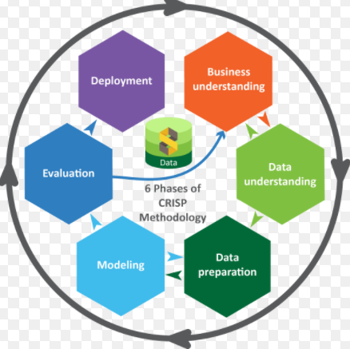
Project Cycle

Slide 4

Business Understanding

Slide 5
Introduction
Rossmann store is a huge European drug store spanning over 3000 locations. They have given data related to 15 features of 1115 stores.
We aim to provide strategic solution to Rossmann managers who are tasked to predict the reliable sales for these stores.
In this project, we are applying data mining techniques to visualize the data, making use of different predictive models to predict how the sales would vary based on different conditions, for stores in different locations. This will help store managers to create effective staff schedules and stock their inventory to increase profit in parallel to giving good customer service.
We have also looked into data and their relationships between with respect to different aspects to help understand the final results.

Slide 6
Project Definition
As the given feature is only store related and there is no
customer related data or item related data, data mining techniques are hard be applied in the problem.
The target(sales) is continuous, the problem could be a regression problem based on both categorical feature(e.g, Store Type) and
continuous feature(e.g, Days).
Some feature could be considered as categorical as well as continuous, for example, Day in week could be considered as continuous by
[1,2,3,4,5,6,7], assuming there is a relationship for adjacent
days or as categorical [Mon, Tue, Wed, Thu, Fri, Sat, Sun],
assuming there is not relationship between them.
Sales prediction could be done by customer related features,
store related features, and item related feature

Slide 7

Data Understanding
Most retailers wish they knew more about their sales and customers’ buying habits.
They want to know the right levers to push and pull to increase sales and customer satisfaction.
However, there are many obstacles in their way that keep them knowing this insightful information.
We are acting as analysts for Rossmann Drug store.
Train.csv, test.csv, Store.csv is provided and we have been merging, analyzing to get a clear picture of the sales data and predict a way out that could help improve their sales.
.

Slide 8
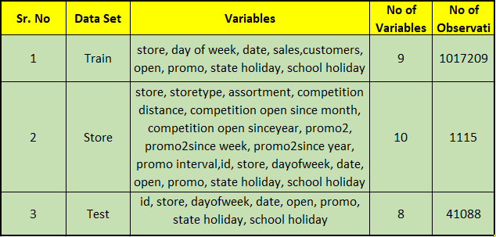
Dataset

Slide 9
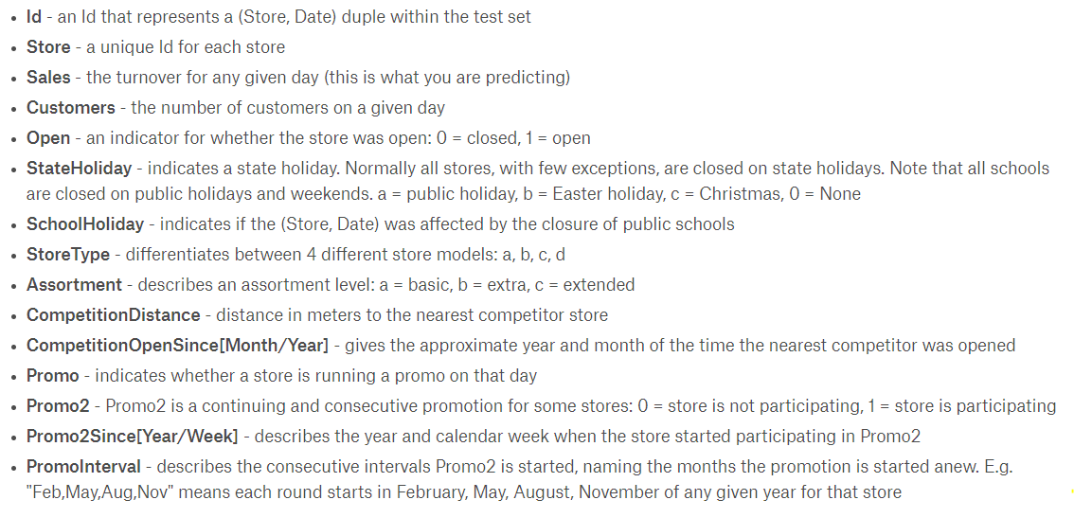
Metadata

Slide 10

Data Preparation
Data Preparation is the procedure by which the data is collected, cleaned, and consolidated, to be used in analysis.
The following steps are considered while doing data preparation:
Cleansing
Combining with Other Data
Creation of New Variables
Binning, Discretization
Normalization of Numeric Variables

Slide 11
Missing Values
The train and test dataset do not have any missing values. But the store dataset has missing values.
The missing values are as follows:
Missing values for CompetitionDistance is 3,
Missing values for CompetitionOpenSinceMonth is 354,
Missing values for CompetitionOpenSinceYear is 354,
Missing values for Promo2SinceWeek is 544,
Missing values for Promo2SinceYear is 544,
Missing values for PromoInterval is 544.

Slide 12
Missing Values
The following criteria’s where chosen for data imputation of missing data which are as follows:
1.Replace the missing value with some constant.
StateHoliday in the train data set had categorical values with the following values which where replaced as shown below:
a : indicates public holiday => 2,
b : indicates Easter holiday =>3,
c : indicates Christmas =>4,
0 : indicates no holiday.

Slide 13
Missing Values(contd.)
2. Replace the missing value with the field median and mode.
i) In the store dataset, replace the mode value for the values missing in the CompetitionOpenSinceMonth column of store dataset.
3. Replace the missing values with a value generated at random from the observed distribution of the variable.
4. Replace the missing values with imputed values based on the other characteristics of the record.

Slide 14
Data Preprocessing
Since the algorithms cannot handle the date column as it is we have to extract numeric values in terms of date, day and year separately.
All of these are factor variables, we will store them as numeric values for now and adjust their data type later.
Apart from the data preprocessing we have performed following tasks before we run the algorithm
The “test” table cannot be used for testing purposes directly since it does not include any relevant data.
It is used only for generating the predictions, which in turn assesses predictions using a root mean squared percentage error metric.

Slide 15

Target Variable
The target variable is sales, the statistics for sales are tabulated below.

Slide 16
Exploratory Data Analysis
Exploratory Data Analysis is an approach for data analysis that employs a variety of techniques to :
Maximize insight into a data set,
Extract import variables and
Test underlying assumptions.
In the following task we are trying to analyze dataset and figure out useful features that can be used to forecast sales.
At first, we will attempt to extract features from training dataset. Then, in order to get more useful features, the store information will be reviewed
At last, we will try to get more information from what we have now based on store information.

Slide 17
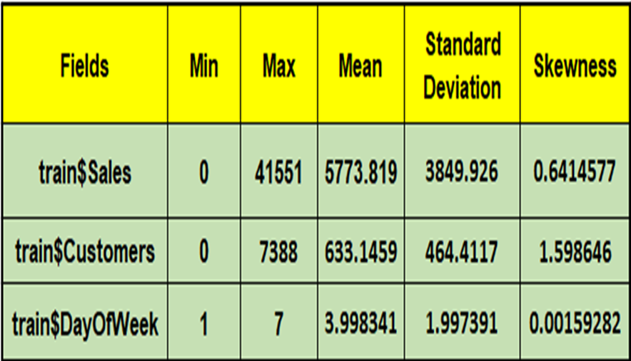
Exploratory Data Analysis(contd.)
In test set, there is only 856 stores which are included in training set which contains 1115 stores.
We need to generate models for 856 stores instead of the total of 1115.
In training set, the period range is from 2013-01-01 to 2015-07-31.
In test set, the period we need to predict is from 2015-08-01 to 2015-09-17.

Slide 18
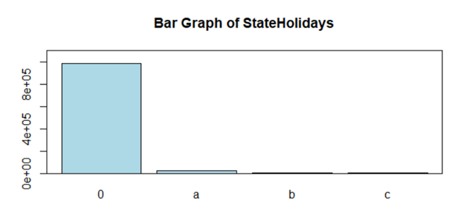
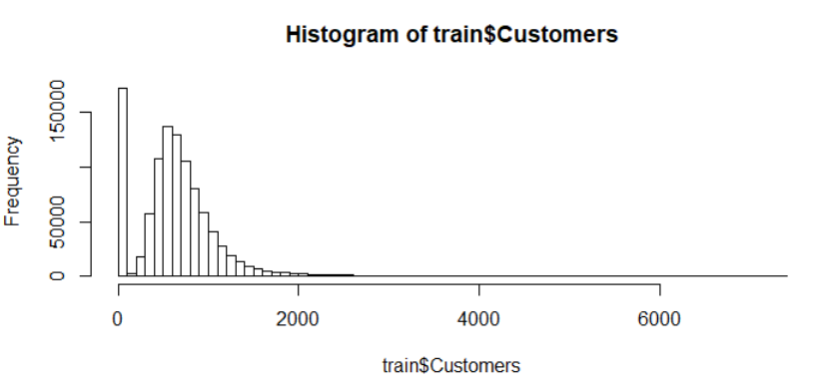
Exploratory Data Analysis(contd.)
From the visuals, we can infer that sales are very high during the public holidays, sales are equally distributed during all days of the week, frequency of distribution of customer data in train data set is right skewed.

Slide 19
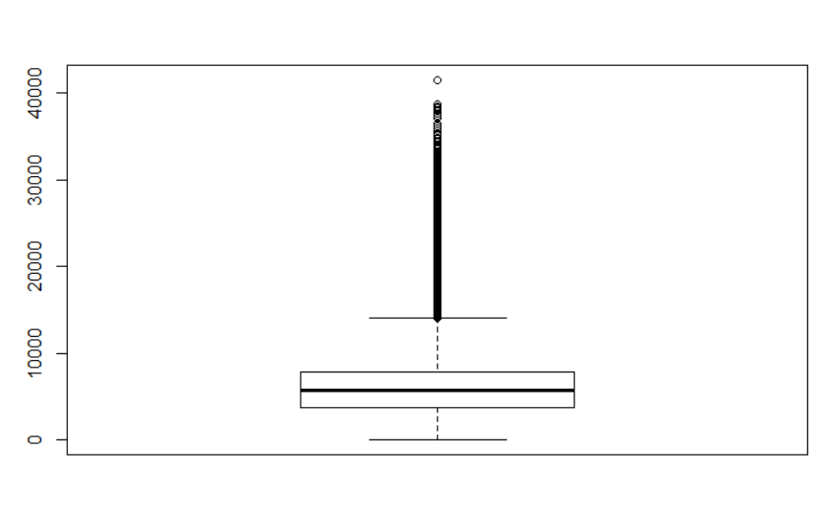
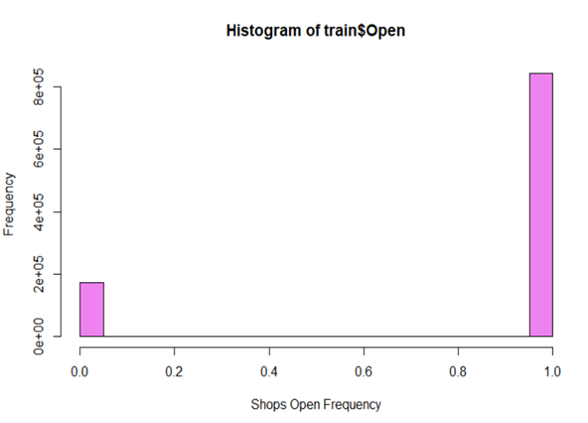
Exploratory Data Analysis(contd.)
From the boxplot of sales in train dataset, we can infer that, the data is normally distributed, with few outliers. Sales above 20000 appear to be outliers in the data set, so these should be checked in order to ascertain that the data are not corrupted and handled in data preprocessing steps.
From the histogram, Rossmann stores are open most of the days. With being closed only for few days.

Slide 20
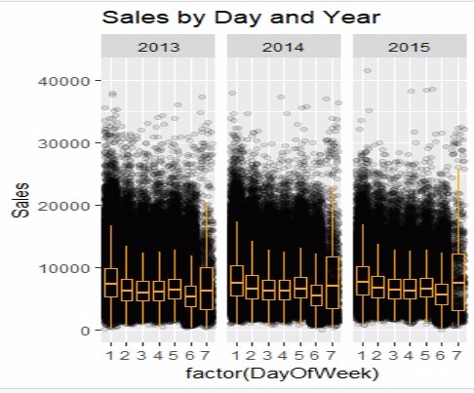
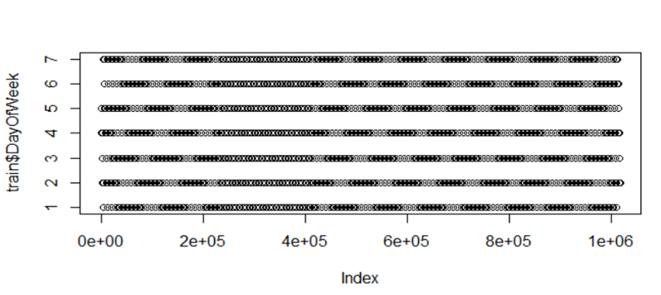
Exploratory Data Analysis(contd.)
summary(train[train$Sales > 20000,])
It could be claimed that certain stores (1114, 262, etc.) consistently produce very high sales. It is also worth noting that the exceedingly high sales are spread across all kinds of dates (also over all days of the week, Monday being the best day for sales by far), school holiday or not, promo or not, etc. We can conclude that the data are probably completely dependable and of very high quality

Slide 21
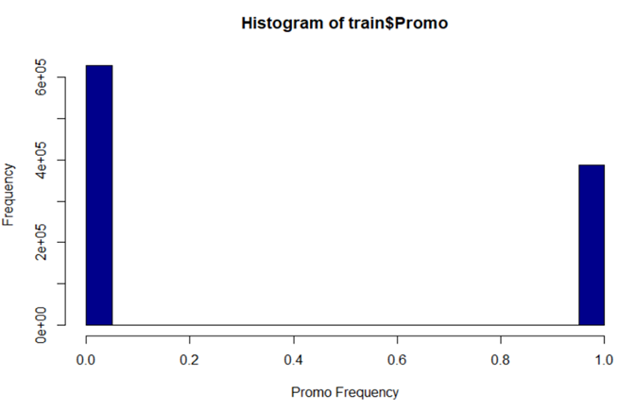
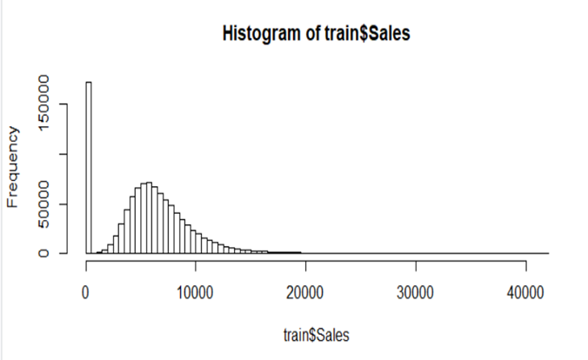
Exploratory Data Analysis(contd.)
The frequency distribution of sales was right skewed in the train data set,
also the histogram of train$promo, sales were high even when there are no promos available.

Slide 22
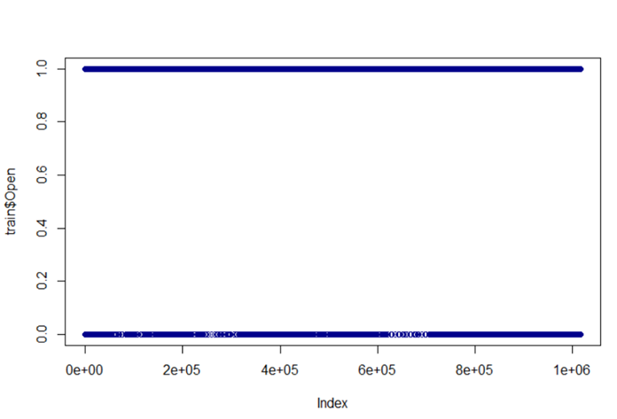
Exploratory Data Analysis(contd.)
The sales of closed shops are zero. Therefore, predicting sales for closed shops is not relevant, so we removed all data for closed shops from the data set, which reduces its size by almost one-fifth.
length(train$Sales[!train$Open]) / nrow(t)
##[1]0.1698933

Slide 23
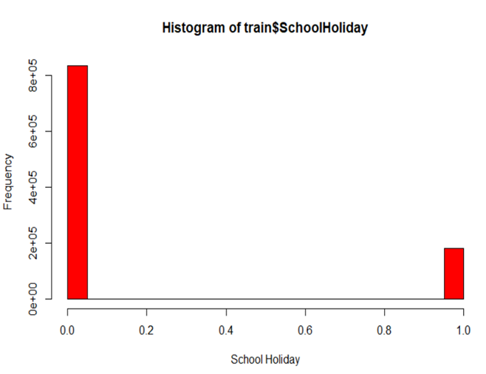
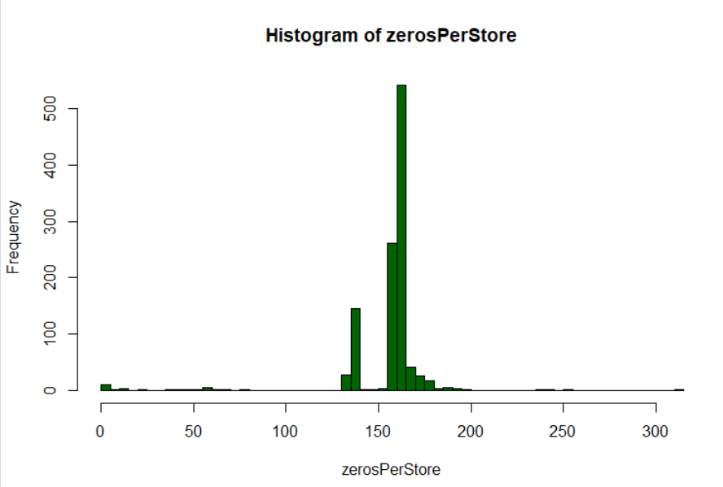
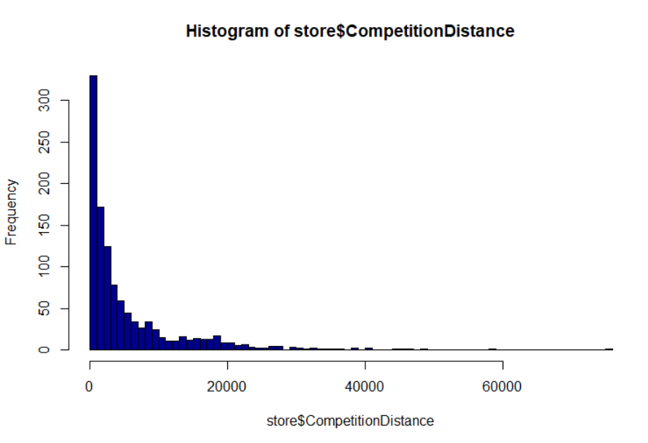
Exploratory Data Analysis(contd.)
We can infer from the graph that, sales with respect, distance from the competitor store is right skewed, graph representing stores with zero sales is symmetric, in the 3rd graph, we can see that, most of the Rossmann stores are closed during the schoolHolidays.

Slide 24
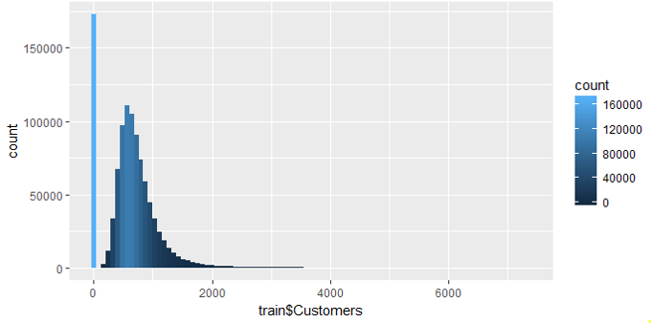
Exploratory Data Analysis(contd.)
The above graph shows the max count of customer in a day at different stores, we can infer that, customers data in train data set is right skewed.

Slide 25
Inferences post EDA
All test stores are present in train dataset. The remaining 259 stores are present in train dataset which is not present in test dataset.
Type of Store plays an important role in opening pattern in stores.
Majority of stores remains close on state holiday.
Few more inferences are claimed by visualizing the data which are shown in the below graphs.
It could be claimed that certain stores (1114, 262, etc.) consistently produce very high sales. It is also worth noting that the exceedingly high sales are spread across all kinds of dates (also over all days of the week, Monday being the best day for sales by far), school holiday or not, promo or not, etc. We can conclude that the data are probably completely dependable and of very high quality.

Slide 26
Inferences post EDA(contd.)
We are checking for the data sufficiency for the available stores:
openDays <- aggregate(new_train$Store,list(new_train$Store),length)
head(openDays)
Results:
Group.1 x
1 1 781
2 2 784
3 3 779
4 4 784
5 5 779
6 6 780
We have historical data on about 781 days for store 1, etc. Statistics for all stores show that we have a rather balanced number of open days, with some outliers but very little variation otherwise.

Slide 27
Inferences post EDA(contd.)
Promotions have a very significant effect on sales, which are about 40 per cent higher on average during promotions.
State holidays of all types have a very large effect on sales as well, whereas the impact of school holidays is relatively negligible, although statistically still highly significant.
tapply(new_train$Sales,new_train$Year,mean)
2013 2014 2015
6814.755 7026.106 7088.235
# Sales are growing each year.
tapply(new_train$Sales,new_train$Date,mean)
Sales based on month:
tapply(new_train$Sales,new_train$Month,mean)
1 2 3 4 5 6 7 8 9 10 11 12
6564.299 6589.494 6976.818 7046.487 7106.808 7001.402 6953.576 6649.229 6547.469 6602.967 7188.554 8608.957
The sales are highest in December, during the holiday season, whereas they are about constant with little variation during the other months.

Slide 28
Predictors Variables
DataSet | Predictor Variables
Store DataSet | The variables include: competitiondistance, competitionopensincemonth, competitionopensinceyear, promo2, promo2sinceweek, promo2sinceyear and promointerval.
Train Data Set | The variables include: DayOfWeek Date Sales Customers Open Promo StateHoliday

Slide 29
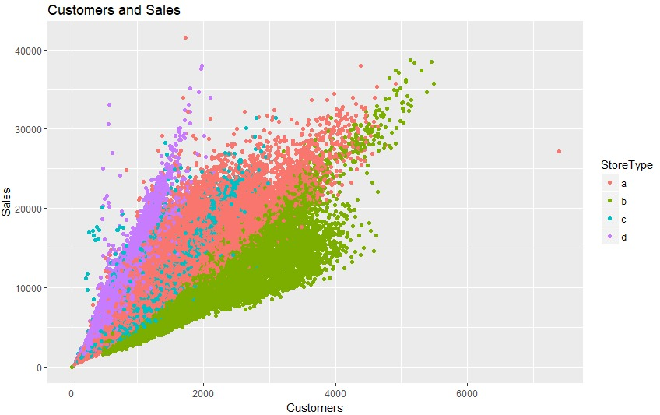
Predictor Variable – Customer
From the graph we can infer that, the sales were highest when there were many customers, thus Sales is strongly correlated with the number of customers and hence customers can be one of the predictor variables.
But there's a catch!! but we are not sure about the interest of future customers, so we neglect number of customers.

Slide 30
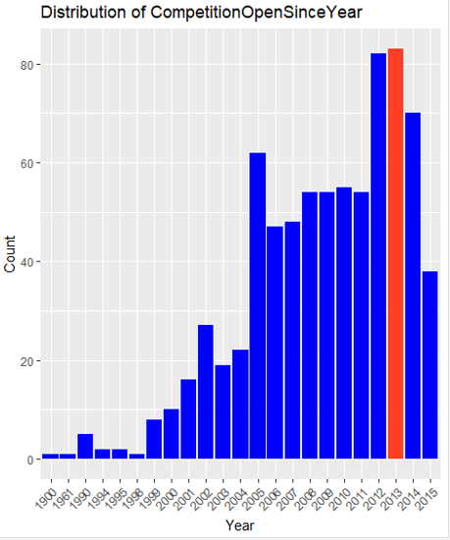
Predictor Variable-OpenSinceYear
The graph depicts the effect of competitor on sales. We can claim that competition is very high in 2012 and 2013. This can be one of the predictors that can help us unearth the reasons for high sales.

Slide 31
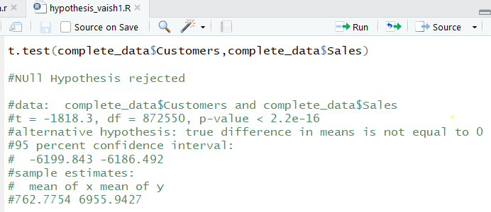
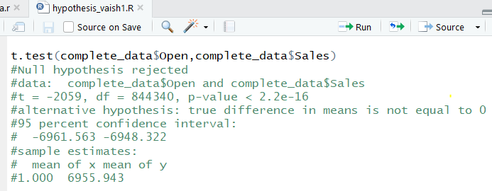
Hypothesis Testing results

Slide 32
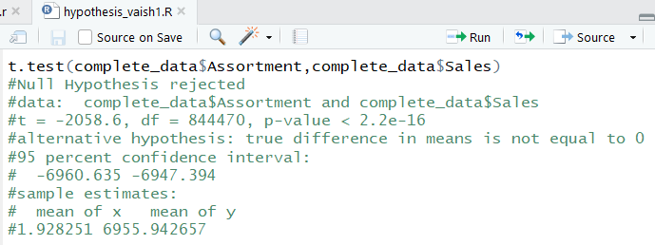
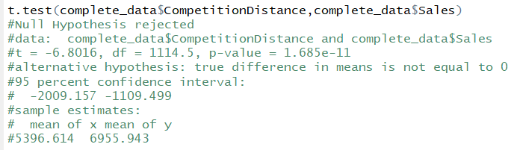
Hypothesis Testing results

Slide 33
Hypothesis Testing inference
We have performed hypothesis testing on different variables like
customers at the Rossmann store,
promos by the Rossmann,
Competition of stores information like,
a) how far is the competition store from Rossmann store and
b)from how many months,
years the competition store is present and
different promos active at those stores with regards to, from how weeks and years.
All these variables against the sales variables which is our predictor variable.
We have seen that, p value is always very small, thus, it gives us strong evidence against null hypothesis. So we have rejected the null hypothesis.

Slide 34

Analysis of relationship between variables
What is the factors that result in no sales?
Sometimes there are promotions but the stores are closed.
Sometimes the stores are open but with no sales.
Sometimes there are no customers even if the stores are open.
Sometimes customers are in store but buying nothing.
Findings | Result
The count of stores participating in promo and not participating in promo when the sales is zero and when the sales are greater than zero.

Slide 35



Analysis of relationship between variables
The count of stores opened and closed when the sales is zero and when the sales greater than zero.
The count of closed and opened stores when the customer count is zero and customers > 0.
The count of sales vs customer when sales is zero and customers are zero, sales zero and customers more than zero and vice versa.

Slide 36
Analysis of relationship between variables
Analyzing the above results we can find the factors that results in no sales, impact of sales when there are promotions but stores are closed, the stores are opened during promotions but no sales, and sometimes the stores are opened on promotion but no sale.
Hence it can be inferred that various factors are involved in the sales and not just one factor is involved.
Promos, open ,close ,month, day ,competitationDistance variables can act as the predictors.

Slide 37
Skewness
Skewness indicates whether the observations in a data set are concentrated on a particular side.
Positive skewness indicate that the mean of the data values is larger than the median, and the data distribution is right-skewed.
Negative skewness indicates that the mean of the data values is less than the median, and the data distribution is left-skewed.

Slide 38
Field | Value | Inference
Sales | 1.594886 | Right Skewed
Promo | 0.2158176 | Right Skewed
Customers | 2.789018 | Right Skewed
DayOfWeek | 0.01931127 | Right Skewed
Open | NA
SchoolHoliday | 1.551107 | Right Skewed
StateHoliday | NA
CompetationDistance | 2.926498 | Right Skewed
CompetatiionOpenSinceMonth | -0.7127349 | Left Skewed
CompetatiionOpenSinceYear | -8.394522 | Left Skewed
Promo2 | -0.04837954 | Left Skewed
Promo2SinceWeek | 1.095292 | Right Skewed
PromoInterval | -0.0810483 | Left Skewed

Slide 39
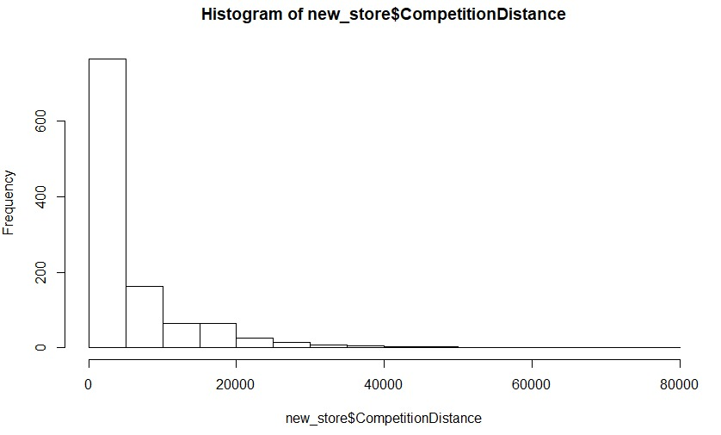
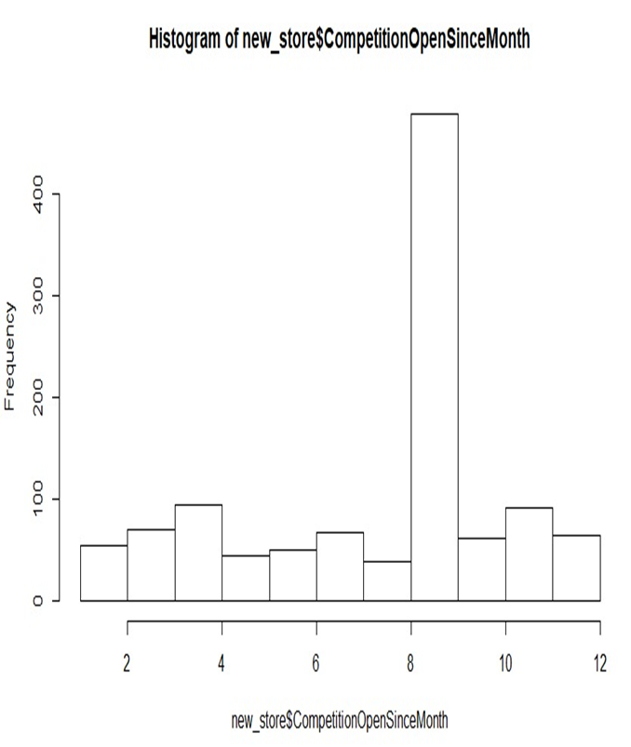
Skewness Graphs

Slide 40
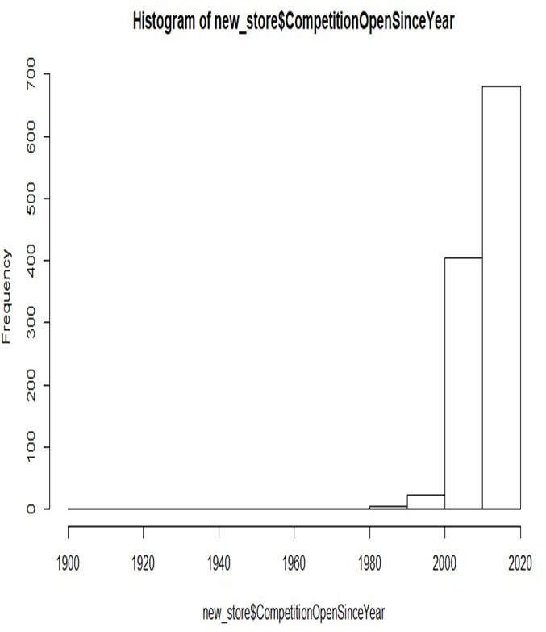
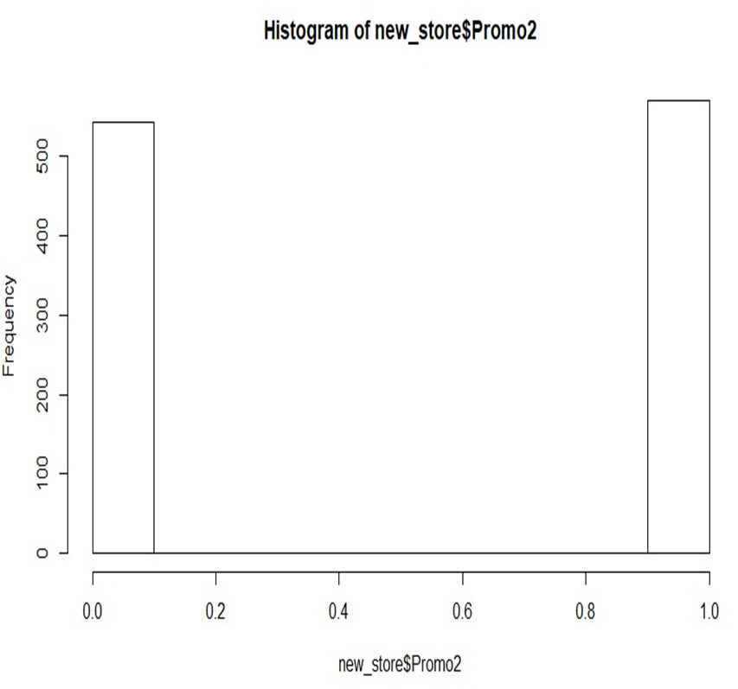
Skewness Graphs

Slide 41
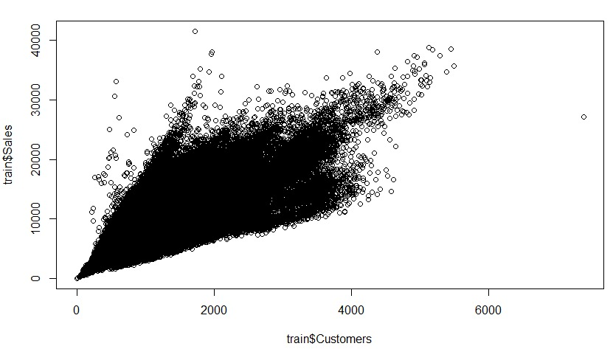
Correlation Matrix
For store dataset, we have to normalise the predictors and calculate the correlation matrix.
Sales are always dependent on the Customers and moreover it is a demand and supply relationship that is always a major influence.
Still it is highly unpredictable to judge or consider the Number of Customers and Analyze the sales in past and predict the future, it is highly not relatable and is bound to vary and leap beyond expectations.
Apart from the fact that Discounts, something unique may attract the Customers but if you try to think in a reverse fashion here does not always serve the purpose.

Slide 42
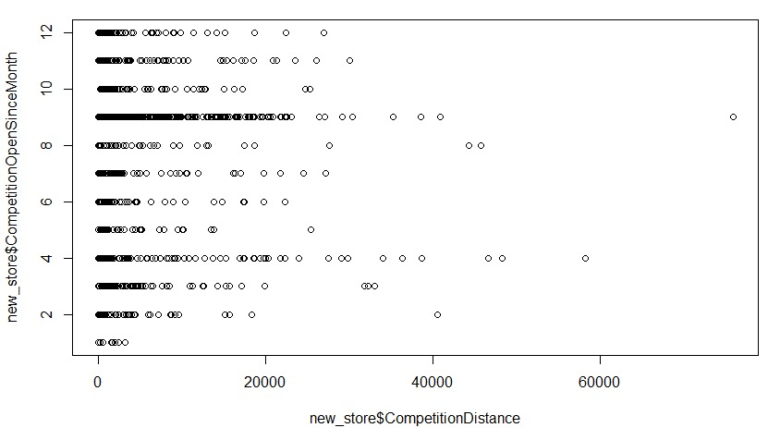
Correlation Coefficient

Slide 43
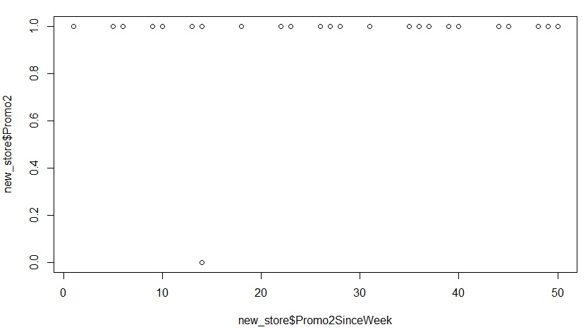
Correlation Coefficient

Slide 44
Correlation Coefficient
Variables Considered | Correlation Coefficient
DayOfWeek | -0.1787504
Customers | 0.8235534
Promo | 0.3681906
SchoolHoliday | 0.03863688
Store | 0.007715013
Assortment | 0.1090163
CompetitionDistance | -0.03590433
CompetitionOpenSinceMonth | -0.03616826
CompetitionOpenSinceYear | 0.01049342
Promo2 | -0.1275554
Promo2SinceWeek | -0.0002274698
Promo2SinceYear | -0.05944384
PromoInterval | -0.006549028

Slide 45
Correlation Coefficient
DayOfWeek – The Sales is different for everyday and it is crucial to consider DayOfWeek as an factor that affects our target variable. The correlation coefficient is – 0.1787
Customer – The number of Customer really has an impact directly on the Sales. Correlation Coefficient is 0.8235534.
Promo – Indicating factor, it is attractive for the customers and helps decide is Promo really affects the sales. Correlation Coefficient is 0.3681906.
SchoolHoliday – On Holidays the crowd coming in to the store has different demands then on regular days. Correlation Coefficient is 0.03863688.
Store – The sales varies from store to store, hence we need to consider this factor. The correlation coefficient between Store and Sales is 0.0077
.

Slide 46
Correlation Coefficient
Assortment – Every store has different assortment levels and that in turn affects the customer and he judges the store accordingly and indirectly affecting the store sales. The correlation
coefficient between Store and Sales is 0.1090163.
CompetitionDistance-
Competitors always affect business and how far the competitor is located cannot be ignored.
The correlation coefficient between CompetitionOpenSinceMonth and Sales -0.03590433
CompetitionOpenSinceMonth –
Since how many months has the sales been affected negatively after the Competition store was established.The correlation coefficient between CompetitionOpenSinceMonth and Sales -0.03616826

Slide 47
Correlation Coefficient
CompetitionOpenSinceYear –
The correlation coefficient between CompetitionOpenSinceYear and Sales 0.01049342
Promo2-
Just like Promo, Promo2 affects the Sales.The correlation coefficient between Promo2and Sales -0.1275554
Promo2SinceWeek –
The correlation coefficient between Promo2SinceWeek and Sales -0.0002274698
Promo2SinceYear –
The correlation coefficient between Promo2SinceYear and Sales -0.05944384
PromoInterval- The correlation coefficient between PromoInterval and Sales -0.006549028

Slide 48
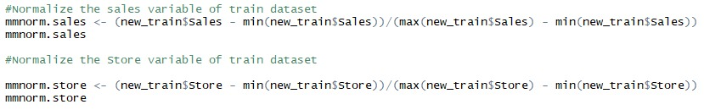
Normalization
In the project , we have made use of Min Max technique that helps to normalize the data. It will scale the data between the 0 and 1.
Normalizing both the target and predictor variables from the train data set. Such that all the values of the variables are in the standard form.

Slide 49
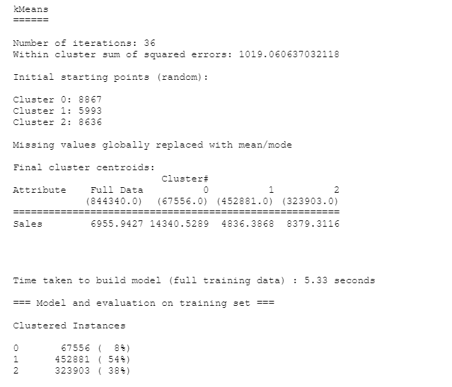
Data Modeling
Unsupervised Learning Method
K-means Clustering
The goal of this algorithm is to find groups in the data, with the number of groups represented by the variable K
Cluster data based on their similarity.
The total number of clusters taken is 3.
We are making use of WEKA datamining tool to cluster the sales variable into 3 clusters.

Slide 50
Data Modeling
Supervised Learning Method
Random Forest
Random Forest Tree tries is to construct a multitude of decision trees. Then it classifies the data into the decision tree node and for each node it calculate the mean value and use this value for prediction. Random forest tree uses random amount of data for training. With this randomized data, it is hard for random forest tree to overfit. Therefore, it is much more easier to tune the data compared to Gradient Boostingtree.
Linear Regression
Linear regression is a statistical procedure for predicting the value of a dependent variable from an independent variable when the relationship between the variables can be described with a linear model.

Slide 51
Data Model-Selection
Model Selection:
We tried several models in our experiment. The first
model we tried is the linear regression. The prediction
score is 0.xxxx and we set it as the prediction baseline.

Slide 52
Data Modeling-Linear Regression
Have divided up the training data by store and constructed the models separately for each store.
From the initial analysis, it was identified that the store variable is by far the strongest predictor for the sales.
Computing for all stores at once requires gigabytes of memory and takes hours. and so we ran only the first 100 stores with a tree size of 1000 where RMSE result was better than linear regression model.
Store 1:
[1] "RMSE: 0.1497119081083" user system elapsed 0.13 0.00 0.12
Store 262:
[1] "RMSE: 0.192849374208426" user system elapsed 0.12 0.00 0.13

Slide 53
Data Modeling-Random Forest
Original with the training data is transformed where the input variables are treated as categorical and replaced by separate binary variables in each level.
The date variable is converted into DateYear ,DateMonth and DateDay separately.
The RMSE error for the linear model is comparatively high compared to the random forest.
Store 1:
[1] 0.06211109 user system elapsed 43.50 0.70 45.47
Store 262:
[1] 0.05019734 user system elapsed 59.20 0.69 60.88

Slide 54
Model Comparison
Model Selection | Score
Linear Regression Store 1 | 0.1497119081083
Linear Regression Store 262 | 0.192849374208426
Random forest Store 1 | 0.06211109
Random forest Store 262 | 0.05019734
We will first experiment with linear regression model. We train a separate model for each store on the complete set of features and assess the accuracy of the predictions of these models using 10-fold cross-validation on each store.
There are about 800 days of data for every store, so the folds contain about 80 records each. We are establishing the results of Linear Regression as the baseline prediction. The aim is to reduce the MSE attained through modeling as much as possible below this amount.
We tried increasing the value of trees up to 2000 but only saw significant improvement, while execution time grew significantly, so Random forest model represents a good compromise between quality and practicality. Results for stores 1 and 262 are clearly better than those that were attained using linear models. Execution takes a couple of seconds for each shop.

Slide 55
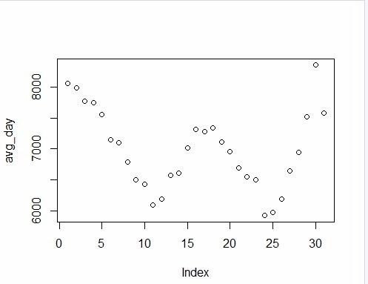
Result Analysis
The top features that can be claimed from the dataset and run of algorithms are as follows:
CompetitionOpenDays,day, store, Month, year are the predictors that impact the sales in the dataset.
Earlier we claimed that days since the competitor opening has a negative influence on the Sales because usually there would be a lot of discounts on the first several days of new competitor opening.
The Sales of the previous store will have a drastic decrease on Sales. But as the time goes, the influence would decrease.
The day and store are the original information from the dataset. It is obvious that different stores would have different sales trend.

Slide 56
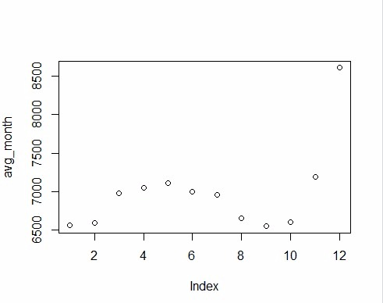
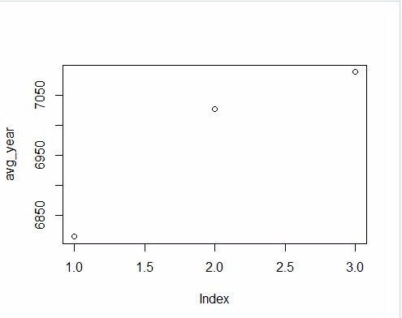
Result Analysis(contd.)
The day in a month has a big influence on the prediction. We guess that the sales have a seasonal fluctuation.
StoreMonthCustomers and StoreDayAverage are the features that we mined in our analysis.
We use the average month sales to represent the store’s monthly fluctuations. But for the same day of week, they might have the same trend. For example, weekends are more likely to have more sales compared to weekdays. As we discussed from our EDA

Slide 57
Forecasting
The whole objective is to use the training data and with the use of those functions in the forecast package to forecast sales for all stores over the entire time series.
We have forecasted the sales values for the store 13.
First, we will need to load the dataset to get information we need on store openings and promos during the period we are trying to forecast.
We have used ARIMA model to forecast the daily data.
Certain imputations are made on the dataframe in order to get the best fit for the ARIMA model.
The major variables used in the model are Date, Promo and holiday to forecast the sales data for the store 13.

Slide 58
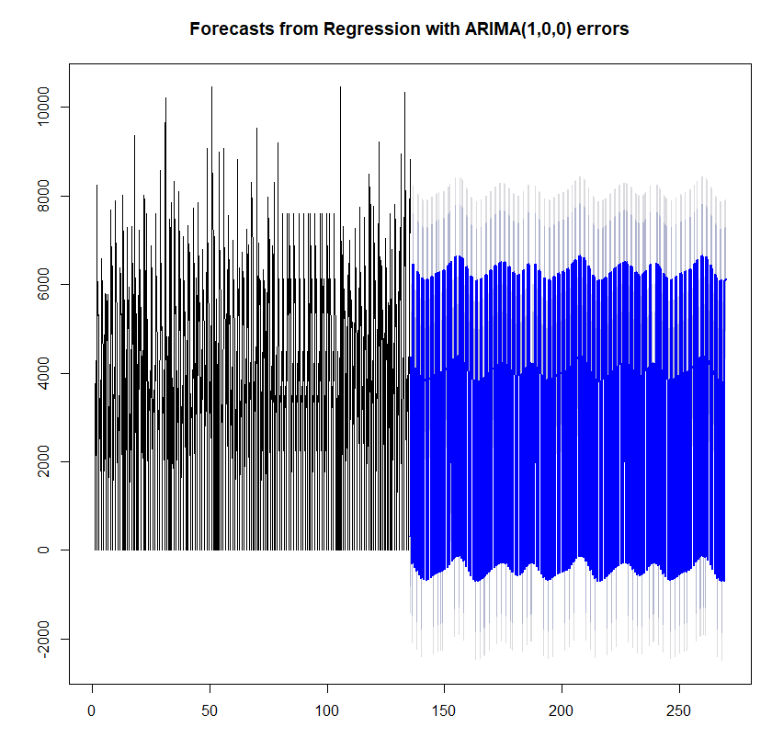
Forecasting with raw data

Slide 59
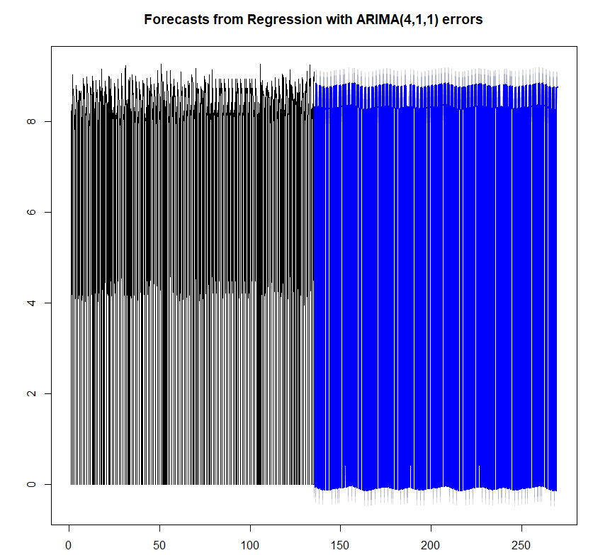
Forecasting with log data

Slide 60
References
https://www.r-bloggers.com/how-to-learn-r-2/#h.bosdu7kkoym
https://www.kaggle.com/
https://www.statmethods.net/stats/index.html

